Slide 1

Professional Practices (HUM-305)
SPRING SEMESTER 2026
By
Prof Engr Muhammad Raheel Iqbal Butt
Resource Person
Contact: +92 321 7433568
School of Computer & Information Technology
Beaconhouse National University, Lahore

Slide 2


Slide 3
Chap 7 Evaluating And Controlling Technology
Evaluating Information
The Need for Responsible Judgment
Computer Models
The “Digital Divide”
Trends in Computer Access
The Global Divide and the Next Billion Users
Neo-Luddite Views of Computers, Technology, and Quality of Life
Criticisms of Computing Technologies
Views of Economics, Nature, and Human Needs Making Decisions About Technology
Intelligent Machines and Super intelligent Humans—Or the End of the
Human Race?

Slide 4
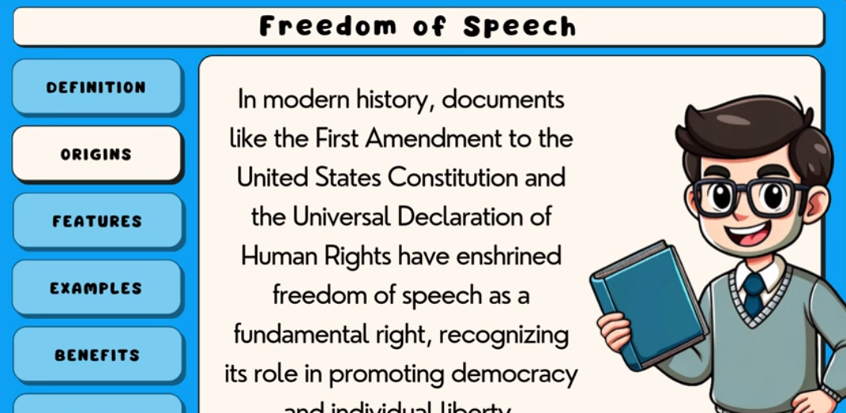
Video
https://youtu.be/Vz3KVBu6lxM

Slide 5


Slide 6
1. Evaluating Information
Ability to assess accuracy, reliability, and relevance of information
Important in the age of fake news, misinformation, and AI-generated content
Key evaluation criteria:
Source credibility (author, organization)
Evidence and references
Bias and objectivity
Timeliness (updated data)
Critical thinking is essential to avoid misleading conclusions

Slide 7
2. The Need for Responsible Judgment
Technology decisions impact society, privacy, and ethics
Requires:
Ethical reasoning
Awareness of social consequences
Accountability in decision-making
Professionals must balance:
Innovation vs risk
Profit vs public welfare
Example: Data privacy vs business analytics
Notes:
# 2. The Need for Responsible Judgment
* Technology decisions impact **society, privacy, and ethics**
* Requires:
* **Ethical reasoning**
* Awareness of **social consequences**
* **Accountability** in decision-making
* Professionals must balance:
* Innovation vs **risk**
* Profit vs **public welfare**
* Example: Data privacy vs business analytics

Slide 8
# 3. Computer Models
Mathematical or simulation-based systems used to **predict outcomes**
* Used in:
* Weather forecasting
* Business decision-making
* Healthcare and research
* Advantages:
* Fast processing of complex data
* Helps in **decision support**
* Limitations:
* Based on assumptions → may be inaccurate
* “Garbage in, garbage out” problem

Slide 9
# 4. The Digital Divide
* Gap between people who have access to technology and those who don’t
* Types:
* **Access divide** (devices, internet)
* **Skill divide** (digital literacy)
* Causes:
* Poverty
* Lack of infrastructure
* Education level
* Effects:
* Inequality in education, jobs, and opportunities

Slide 10
# 5. Trends in Computer Access
* Increasing use of:
* Smartphones
* Cloud computing
* Internet services
* Growth in:
* Remote work
* Online education
* Shift from **desktop → mobile-first world**
* However, inequality still exists in rural vs urban areas

Slide 11
# 6. The Global Divide and the Next Billion Users
* Focus on connecting the **next billion users** (mostly in developing countries)
* Challenges:
* Infrastructure
* Cost of devices and internet
* Language barriers
* Opportunities:
* Economic growth
* Education access
* Digital inclusion
* Companies expanding into **Asia, Africa, and rural regions**

Slide 12
7. Neo-Luddite Views of Technology
* Neo-Luddites criticize rapid technological growth
* Concerns:
* Loss of jobs due to automation
* Overdependence on machines
* Reduced human interaction
* Believe technology may **harm quality of life**
* Advocate for **controlled and limited use of technology**

Slide 13
8. Criticisms of Computing Technologies
* Privacy invasion (data tracking, surveillance)
* Cybercrime and hacking
* Job displacement due to automation
* Health issues:
* Screen addiction
* Reduced physical activity
* Environmental concerns:
* E-waste
* Energy consumption

Slide 14
9. Views of Economics, Nature, and Human Needs
* Technology affects:
* **Economy** → productivity, jobs, global trade
* **Nature** → pollution vs green tech
* **Human needs** → comfort, communication, healthcare
* Debate:
* Is technology fulfilling real needs or creating artificial ones?
* Balance required between:
* Growth and sustainability

Slide 15
10. Making Decisions About Technology
Requires:
* Cost-benefit analysis
* Ethical considerations
* Risk assessment
Questions to ask:
* Who benefits?
* Who is harmed?
* Is it sustainable?
Involves stakeholders:
* Government
* Businesses
* Society

Slide 16
11. Intelligent Machines and Superintelligent Humans — Or the End of the Human Race?
Concept
Development of **Artificial Intelligence (AI)** that may surpass human intelligence
Optimistic View
AI can:
* Improve healthcare
* Solve global problems
* Enhance human abilities
* Concept of **human-AI collaboration**
Pessimistic View
Risks:
* Loss of human control
* Job elimination
* Ethical concerns
* Fear of **superintelligent AI dominating humans**

Slide 17
11. Intelligent Machines and Superintelligent Humans — Or the End of the Human Race?
Key Debate
Will AI:
* **Enhance humanity?**
* Or **replace it?**

Slide 18
Conclusion
Future depends on:
* Responsible development
* Ethical guidelines
* Human control over technology

Slide 19


Slide 20


